Slide 1
C# Programming
MAD401

Slide 2
Introduction to C#
Lecture 2

Slide 3
Objectives
Operators and Control Flow
Operators
Control flow statements
Pre-processor directives
Methods and Parameters
Namespaces
Calling and declaring Methods
The using directive
Parameters
Method overloading

Slide 4
Operators and Control Flow
C# contains all of the same basic operators available in Java
Standard Arithmetic Binary Operators ( +, -, *, /, % )
Addition, Subtraction, Multiplication, Division, Modulus
C# follows standard precedence and associativity rules
*, /, and % have highest precedence.
+ and - have lower precedence.
= has the lowest precedence of these six operators.
Can be overridden using parentheses

Slide 5
Operators and Control Flow
The plus operator ( + ) can be used to concatenate two or more strings.
Strings can be concatenated with numerics in the same fashion
Compound Assignment Operators ( +=, -=, *=, /=, %= )
Increment and Decrement Operators ( ++, -- )
Pre and Post fix
Constants are declared by including the keyword const before the datatype
string fullName = firstName + " " + lastName;

Slide 6
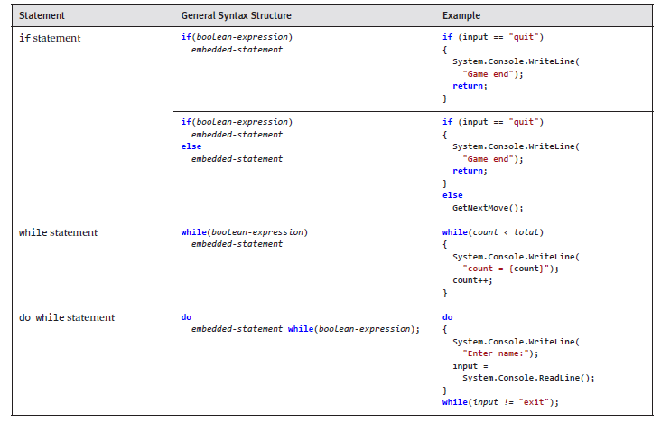
Control Flow Summary

Slide 7
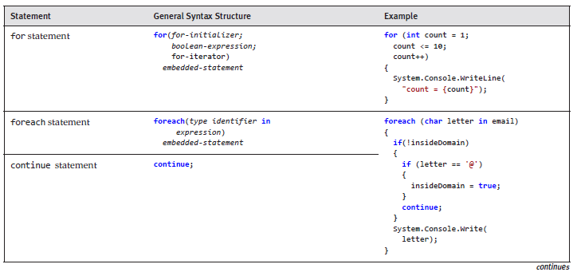
Control Flow Summary

Slide 8
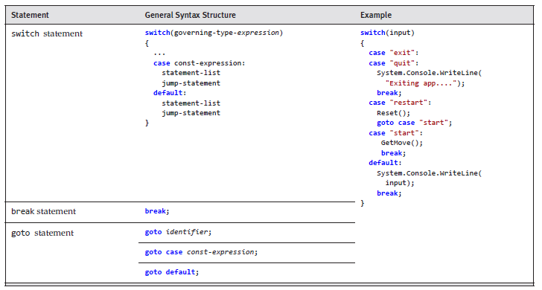
Control Flow Summary

Slide 9
Relational/Equality/Logical Operators
Operator | Description | Example
< | Less than | Input < 9;
> | Greater than | Input > 9;
<= | Less than or equal to | Input <= 9;
>= | Greater than or equal to | Input >= 9;
== | Equality operator | Input == 9;
!= | Inequality operator | Input != 9;
Operator | Description
&& | AND
|| | OR
^ | Exclusive OR
! | NOT

Slide 10
C# Operators
Null-Coalescing Operator ( ?? )
“If a value is null, then use another value”
Null-Conditional Operator ( ?. )
“Check for null before invoking the method or property”

Slide 11
Repetition Structures
Identical to Java
while (condition) {
statement(s)
}
do {
statement(s)
} while (condition);
for (initial; condition; loop) {
statement(s)
}

Slide 12
foreach loop
C# supports the ever useful foreach loop using the following syntax:
The foreach loop iterates through a collection of items, setting a loop variable to represent each item in turn
foreach (type variable in collection) {
statement(s)
}
string[] languages = { "C", "C#", "C++", "PHP", "Java" };
foreach (string lang in languages) {
Console.WriteLine(lang);
}

Slide 13
The switch statement
There is a slight difference in switch statements:
C# does not allow control to fall through from one switch section to the next unless the code area is left empty.
If you want this sort of behaviour, you may do so explicitly with a goto statement
switch (expression) {
case constant:
statements
default:
statements
}

Slide 14
Methods and Parameters
Functions vs. Methods
Because everything in C# extends from Object
Methods are used to group together a sequence of common statements to perform a particular action or compute a particular result.
Methods are always associated with a type
Usually a class, but can be a structure
Methods can receive data via arguments that are supplied for their parameters

Slide 15
Anatomy of a Method
Parameters are variables used for passing data from the caller to the invoked method
Methods can also return data back to the caller via a return value
A fully qualified method name includes a namespace, type name, and method name with a period separating each part.
Note: methods are often called with only part of the their FQN
Why haven’t we been using the namespace when calling the WriteLine() method?
System.Console.WriteLine("Hello World");
Namespace
Type name
Method name
Argument

Slide 16
Anatomy of a Method
After a method name comes the argument list; a comma separated list of values that correspond to the parameters in the method
A method can take any number of parameters; each of a specified data type
A method return value is a means of transferring results from a called method back to the caller

Slide 17
Namespaces
Namespaces are used to group & organize types by area of functionality so they can be more easily found and understood
They are also used to avoid type name collisions
Example: If two types named Button exist, they can be placed in different namespaces so that the compiler can uniquely distinguish the two types
Namespaces are hierarchical and can have any amount of levels
Usually sorted by company name, product name and then functional area:
Example: Microsoft.Win32.Networking

Slide 18
Common Namespaces
C# has a System namespace which contains all the types that enable the programmer to perform many of the fundamental operations
Almost every program uses types within the System namespace
The following table lists the most common namespaces and short description describing their function

Slide 19
Common Namespaces
Namespace | Description
System | Contains the fundamental types, and types for conversion between types, mathematics, program invocation, and environment management.
System.Collections | Contains types for working with collections of objects such as lists and dictionaries.
System.Collections.Generics | Contains strongly typed collections that use generics.
System.Data | Contains types used for working with databases.
System.Drawing | Contains types for drawing to the display device and working with images.
System.IO | Contains types for working with directories and manipulating, loading, and saving files.
System.Linq | Contains classes and interfaces for querying data in collections using a Language Integrated Query.
System.Text | Contains types for working with strings and various text encodings, and for converting between those encodings.
System.Threading | Contains types for multithreaded programming.
System.Xml | Contains standards-based support for XML processing.

Slide 20
Namespace Guidelines
Guidelines while using namespaces for your assignments/projects:
Use the following template for naming namespaces:
<Company>.(<Product>|<Technology>)[.<Feature>][.<Subnamespace>]
Prefix namespace names with a company name to prevent namespaces from different companies from having the same name.
Use PascalCasing, and separate namespace components with periods
Do not introduce generic type names such as Element, Node, Log, and Message.
Do not give types names that would conflict with any type in the Core namespaces.
For example, never use Stream as a type name. It would conflict with System.IO.Stream, a very commonly used type.

Slide 21
Scope
Note: It is not always necessary to provide the namespace when calling a method
If the calling expression appears in the same namespace as the called method
If the using directive is used (import the namespace)

Slide 22
Static Method Scope
Calls to static methods require the type name qualifier if the target method is not within the same type
Example: Console.WriteLine() requires the type Console to be stated
The type name qualifier can be omitted from a method call whenever the method is a member of the same type as the calling expression
The compiler will infer the type from the location
namespace Mad401.Lecture2 {
class Program {
public static void SayHello() {
System.Console.WriteLine("Hello");
}
static void Main(string[] args) {
SayHello();
}
}
}

Slide 23
Scope
A call that appears inside a type declaration to a method declared in that type does not require the type qualifier because the method is “in scope”
Similarly, a type is “in scope” throughout the namespace that declares it; therefore, a method call that appears in a type in a particular namespace need not specify that namespace in the method call name
Note the missing namespace and type in the last example

Slide 24
Declaring a Method
Declaring methods in C# are identical to Java
Note: static, return type declaration, method name, parameter list
namespace Mad401.Lecture2 {
class Program {
static void SayHello() {
System.Console.WriteLine("Hello World");
}
static string Foo() {
return "bar";
}
static void Main(string[] args) {
SayHello();
System.Console.WriteLine(Foo());
}
}
}

Slide 25
Expression Bodied Methods
There is, however, a new style of method declaration as of C# 6.0
C# 6.0 styled expression-bodied method syntax:
In place of the curly brackets, an expression bodied method uses the “goes to” operator
There is no explicit return statement in the method implementation
The “goes to” operator implies a return from the method
static string GetFullName(string firstName, string lastName) =>
$"{ firstName } { lastName }";

Slide 26
The using directive
Namespaces are an organizational mechanism for categorizing and grouping together related types
Namespaces allow two or more types which have the same name as long as they’re within different namespaces
C# includes the ability to “import” all the types from one or more namespaces so they can be used without the FQN.

Slide 27
The using directive
Adding the using directive at the top of the file will perform such import
The namespace may then be omitted
using System;
namespace Mad401.Lecture2 {
class Program {
static void Main(string[] args) {
Console.WriteLine("Hello World");
}
}
}

Slide 28
The using directive limitations
The using directive does not enable you to omit the namespace from a type declared within a child namespace
The using directive does not import types from a nested namespace.
Java allows for importing namespace with wildcards such as:
import java.util.*;
C# does not support wildcards but instead requires each namespace to be imported explicitly

Slide 29
Visual Studio
By default, any new Visual Studio C# project contains the following using directives at the top of the program
using System;
using System.Collections.Generic;
using System.Linq;
using System.Text;
namespace Mad401.Lecture2 {
class Program {
static void Main(string[] args) {
Console.WriteLine("Hello World");
}
}
}

Slide 30
using static directive
The using static directive allows you to omit both the namespace and type name from any member of the stated type.
Example:
Note: If two members with the same signature are available, any invocation of them that was ambiguous would result in a compile error.
using static System.Console;
namespace Mad401.Lecture2 {
class Program {
static void Main(string[] args) {
WriteLine("Hello World");
}
}
}

Slide 31
Aliasing
The using directive can also be used to alias namespaces or types
Helpful when you wish to abbreviate a long name
using CountDownTimer = System.Timers.Timer;
namespace Mad401.Lecture2 {
class Program {
static void Main(string[] args) {
CountDownTimer timer;
}
}
}

Slide 32

Parameters on Main()
C# supports the ability to retrieve the command-line arguments when executing a program and return a status indicator from the Main() method
At runtime, the command-line arguments are passed into Main through a single string array parameter:
using System;
namespace Mad401.Lecture2 {
class Program {
static void Main(string[] args) {
if (args.Length == 1) {
Console.WriteLine($"Command line argument: {args[0]}");
} else {
Console.WriteLine("Invalid command line argument");
}
}
}
}

Slide 33
The Call Stack
Every time a function is invoked, the runtime creates an “activation frame” that contains information about the arguments passed to the new call, any new local variables and information about where control should be resumed when the method returns
This is referred to as the call stack
Stack unwinding is the term used when activation frames are removed from the call stack
Stack unwinding always occurs in revers order from the method call.

Slide 34
Pass by Value vs. Pass by Reference
Arguments to method calls are usually pass by value (value type), which means the value of the argument expression is copied into the target parameter
Arguments may also be passed to methods by reference (reference type)
The value of a reference type variable is a reference to the location where the data associated with the object is stored
The value of a reference type is typically represented as the address of memory location in which the object’s data is stored

Slide 35
Value and Reference Type Behaviour
If the method parameter is a value type, the value itself is copied into the parameter and changing the parameter in the called method will not affect the original caller’s variable.
If a reference type variable is passed by value, the reference itself is copied from the caller to the method parameter
The target method cannot update the caller variable’s value but it may update the data referred to by the reference.

Slide 36
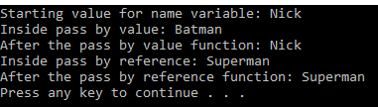
Reference Parameters
using System;
namespace Mad401.Lecture2 {
class Program {
static void PassByValue(string name) {
name = "Batman";
Console.WriteLine($"Inside pass by value: {name}");
}
static void PassByReference(ref string name) {
name = "Superman";
Console.WriteLine($"Inside pass by reference: {name}");
}
static void Main(string[] args) {
string name = "Nick";
Console.WriteLine($"Starting value for name variable: {name}");
PassByValue(name);
Console.WriteLine($"After the pass by value function: {name}");
PassByReference(ref name);
Console.WriteLine($"After the pass by reference function: {name}");
}
}
}

Slide 37


Reference Limitations
When a called method specifies a parameter as ref, the caller is required to supply a variable, not a value as an argument and to place ref in front of the variables passed
In addition, variables must be initialized before they can be passed as ref because the target method could read data from the parameter
using System;
namespace Mad401.Lecture2 {
class Program {
static void ChangeName(ref string name) {
name = "Superman";
Console.WriteLine($"Inside pass by reference: {name}");
}
static void Main(string[] args) {
ChangeName("Batman");
string variable;
ChangeName(ref variable);
}
}
}

Slide 38

out keyword
It is often the case that a method takes a reference to a variable which is intended to be written to but not read from
As such, an uninitialized local variable may be safely passed by reference
To achieve this, they keyword out may be prefixed to the argument and parameter
using System;
namespace Mad401.Lecture2 {
class Program {
static void ChangeName(out string name) {
name = "Superman";
}
static void Main(string[] args) {
string variable;
ChangeName(out variable);
Console.WriteLine(variable);
}
}
}

Slide 39

params keyword
Sometimes it is convenient if the number of arguments may vary
The params keyword allows the number of arguments to vary in the calling code instead of being set by the target method.
using System;
namespace Mad401.Lecture2 {
class Program {
static string Combine(params string[] listOfStrings) {
string result = string.Empty;
foreach (string singleString in listOfStrings) {
result += singleString + " ";
}
return result;
}
static void Main(string[] args) {
var fullString = Combine("string1", "string2", "string3", "string4");
Console.WriteLine(fullString);
fullString = Combine("string1", "string2");
Console.WriteLine(fullString);
}
}
}

Slide 40
params restrictions
The parameter array must be the last parameter in the method declaration. Since only the last parameter may be a parameter array, a method cannot have more than one parameter array.
int Max(int first, params int[] operands)
The caller can specify zero arguments that correspond to the parameter array parameter, which will result in an array of zero items being passed as the parameter array.
Parameter arrays are type-safe. The arguments given must be compatible with the element type of the parameter array.
The caller can use an explicit array rather than a comma-separated list of parameters. The resulting IL code is identical.

Slide 41
Method Overloading
All methods within a class must have a unique signature, and C# defines uniqueness by variation in the method name, parameter data types, or number of parameters.
This does not include method return data types; defining two methods that differ only in their return data types will cause a compile error.
Method overloading occurs when a class has two or more methods with the same name and the parameter count and/or data types vary between the overloaded methods.

Slide 42

Method Overloading
using System;
namespace Mad401.Lecture2 {
class Program {
static string Method1(int num) {
return $"Student ID: {num}";
}
static string Method1(string name, int num) {
return $"Student Name: {name} \nStudent ID: {num}";
}
static void Main(string[] args) {
Console.WriteLine(Method1(012345));
Console.WriteLine(Method1("Nick Sylvestre", 54321));
}
}
}

Slide 43
Optional Parameters
C# has the ability to include default/optional parameters
Note that optional parameters must appear after all required parameters (those that don’t have default values). Also, the fact that the default value needs to be a constant, compile-time–resolved value is fairly restrictive.
using System;
namespace Mad401.Lecture2 {
class Program {
static string method1(string name, int num = 0) {
return $"Student Name: {name} \nStudent ID: {num}";
}
static void Main(string[] args) {
Console.WriteLine(method1("Nick Sylvestre"));
}
}
}

Slide 44
The end of Lecture 02

